Slide 1
Project Based Learning –IV
PAPER VISION AUGMENTED REALITY
TEAM DETAILS
Sonali Saini(2210993848)
Shail Sharma(2210993837)
Group B
FACULTY COORDINATORS
Dr. Chesta Dhingra
Chitkara University Institute of Engineering and Technology,
Chitkara University, Punjab

Slide 2
Table of Contents
Introduction
Problem Statement
Technical Details
Flowchart
Code
Result/Output
Key Features
Conclusion
References/Links used

Slide 3
Introduction
Paper Vision AR is an augmented reality (AR) application that uses computer vision technology to recognize and interpret text from images of paper documents. The application enables users to point their mobile device at a paper document and see the text on the document overlaid with digital information, such as links, videos, or other interactive content.
The application can be used in various industries, including education, healthcare, and marketing, to provide users with a more immersive and engaging way to learn, diagnose, and interact with information.
This application uses machine learning algorithms and neural networks (CNNs) to recognize and interpret the text in the images. The computer vision technology enables the application to accurately identify and interpret text, even in low-quality images or under varying lighting conditions.
Paper Vision AR is a powerful tool for businesses and organizations looking to provide their customers or employees with a more engaging and interactive way to consume information. Paper Vision AR can help businesses and organizations to create more engaging and interactive experiences for their customers or employees.

Slide 4
Problem Statement
The aim of this project is to develop a machine learning-based system that enhances visual perception and interaction in augmented reality environments. The primary challenges to address include real-time object recognition and tracking, semantic understanding of the environment, integration of virtual objects with the real world, and ensuring seamless user experience through efficient computational methods.
In recent years, the fusion of computer vision and augmented reality has shown immense potential in various applications such as gaming, education, healthcare, and industrial training. However, challenges persist in optimizing the accuracy, speed, and robustness of vision-based AR systems, particularly in dynamic environments with real-time interactions. This paper aims to address these challenges by proposing novel machine learning algorithms and techniques tailored specifically for vision AR applications. The primary objectives include improving object recognition accuracy, enhancing real-time tracking and rendering capabilities, and minimizing latency to provide a seamless and immersive AR experience. Through extensive experimentation and evaluation, this research seeks to contribute new insights and solutions to advance the state-of-the-art in vision AR technology.

Slide 5
Technical Details
Open-CV: The OpenCV (Open Source Computer Vision) module in Python is a powerful library widely used for computer vision tasks, image processing, video analysis, and machine learning.
Argparse Module: This module facilitates parsing command-line arguments and options, making it easier to handle user input from the terminal.
NumPy: It is a fundamental Python library for numerical computing, providing powerful tools for working with arrays, matrices, mathematical functions, and linear algebra operations.
OS module: This module provides a way to interact with the operating system, allowing you to perform tasks like file manipulation, directory operations, and environment variables management.
Time module: It provides functions for working with time-related operations, such as measuring execution time, delaying program execution, and accessing system time.
VS Code: It offers a wide range of features and extensions that enhance the coding experience for developers across various programming languages and platforms.
GitHub: GitHub is a widely-used platform for version control and collaborative software development, offering tools like Git integration, issue tracking, and pull requests to streamline teamwork.

Slide 6
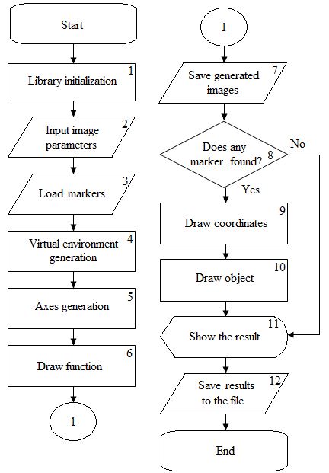
Flowchart

Slide 7
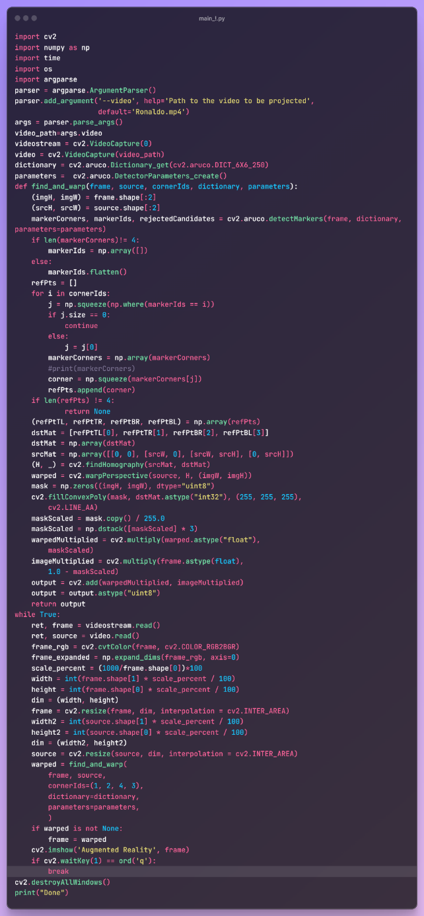
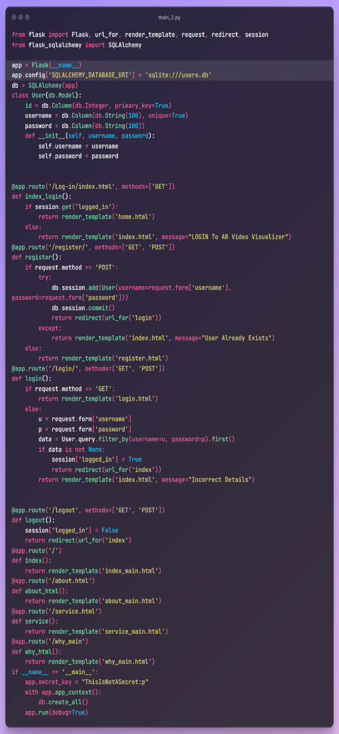
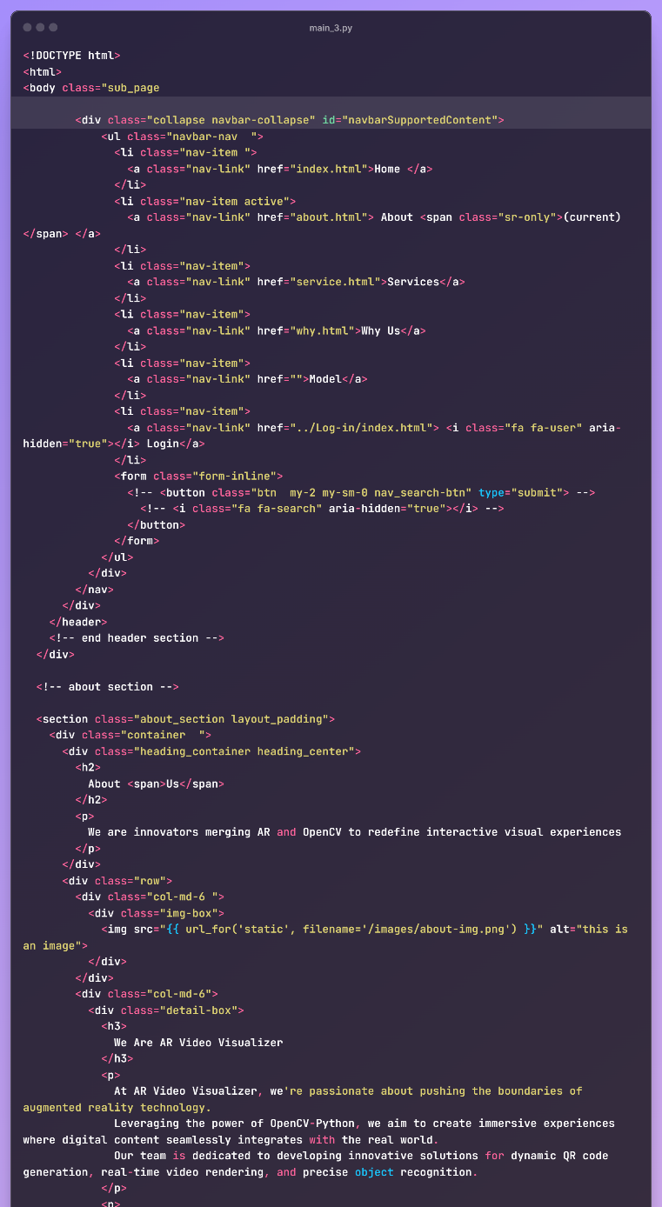
Code

Slide 8


Result/Output

Slide 9
Key Features
1. Real-time Performance Optimization: Paper Vision AR experiences are optimized for real-time performance, ensuring smooth rendering, responsive interactions, and minimal latency.
2. Security and Privacy: Robust security measures are implemented to protect user data, ensure privacy, and prevent unauthorized access, adhering to industry standards and regulations for data protection.
3. Scalability and Extensibility: The system is designed for scalability and extensibility, allowing for the integration of new features, modules, and third-party services to meet evolving user requirements and technological advancements.
4. Dynamic Content Generation: Utilizing Paper Vision's capabilities, the project dynamically generates AR content based on user inputs, environmental data, and machine learning insights, ensuring a dynamic and adaptive experience.
5. Data Analytics and Insights: Data analytics tools capture user interactions, providing valuable insights for optimization, personalization, and enhancing the overall AR experience over time.

Slide 10
Conclusion
In conclusion, the integration of Paper Vision AR with machine learning in this project has resulted in a cutting-edge and immersive augmented reality experience.
By leveraging the advanced capabilities of Paper Vision for seamless AR content creation and real-time performance optimization, the project has achieved significant milestones in enhancing user engagement and overall AR usability.
The project's emphasis on intuitive user interfaces, robust object tracking, dynamic content generation, and multi-user collaboration has made it a versatile platform for various applications, including education, training, entertainment, and data visualization.
The incorporation of accessibility features, security measures, and scalability ensures inclusivity, privacy protection, and future-proofing for evolving technological needs.
Overall, this project represents a convergence of state-of-the-art technologies, pushing the boundaries of augmented reality and machine learning integration to deliver compelling, interactive, and impactful AR experiences that resonate with users across different domains and use cases.

Slide 11
References/Links used
https://www.mdpi.com/2076-3417/12/10/5159
https://www.researchgate.net/publication/352809530_Augmented_Reality_and_Machine_Learning_Incorporation_Using_YOLOv3_and_ARKit
https://blog.roboflow.com/computer-vision-ar-experiences/
https://www.geeksforgeeks.org/face-recognition-using-artificial-intelligence/
https://pyimagesearch.com/2021/01/04/opencv-augmented-reality-ar/
https://github.com/topics/augmented-reality

Slide 12


